Slide 1

Git Concepts I Wish I Knew Years Ago
Sanjula Ganepola
Software Developer – IBM i App Dev & AI Toolchain
Sanjula.Ganepola@ibm.com
2025 February

Slide 2
Agenda
Git Basics
Using Git in a Team
Branching and Merge Conflicts
Merge Commits vs. Rebase Merging vs. Squash Merging
Using Git on IBM i
Tips and Tricks
Git in VS Code

Slide 3
How well do you know Git?
🤩 Never used it I have not used Git before, but I am interested!
🧐 Beginner I just started learning the basics.
👨‍🎓 Intermediate I understand the basics, but I am not familiar with advanced concepts.
🕵️ Expert I have a deep understanding of Git.

Slide 4
Git Basics

Slide 5
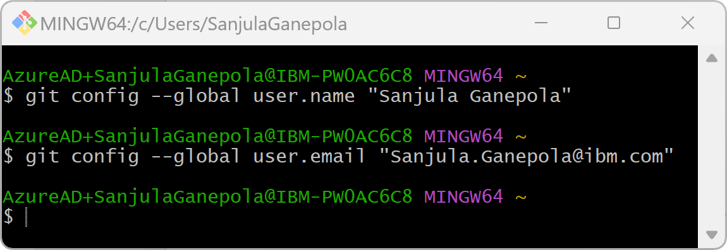
Let’s get setup
Let’s do this once …
Install Git on your PC:
https://git-scm.com/downloads
Setup your name and email in your Git config:

Slide 6
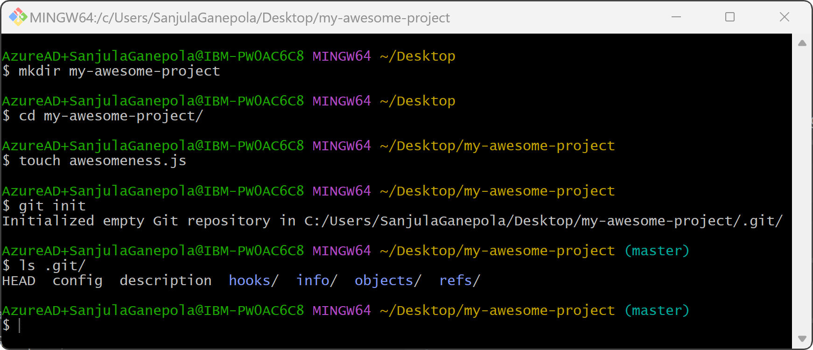
Setup a new project with Git

Slide 7




Where does your code live?
WORKING DIRECTORY
STAGING AREA
LOCAL REPO
REMOTE REPO
Where we actively edit local files (our playground)
Temporary location for changes before committing
Where we store committed changes locally
A sever (such as GitHub) for sharing and backing up code

Slide 8
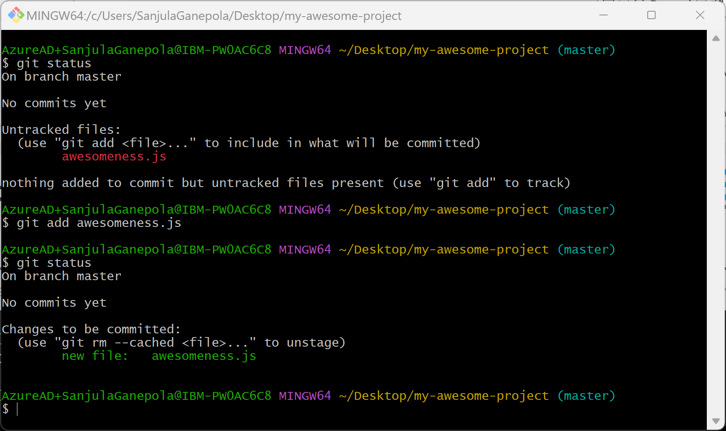
Moving code to the staging area
WORKING DIRECTORY
STAGING AREA
LOCAL REPO
REMOTE REPO

Slide 9
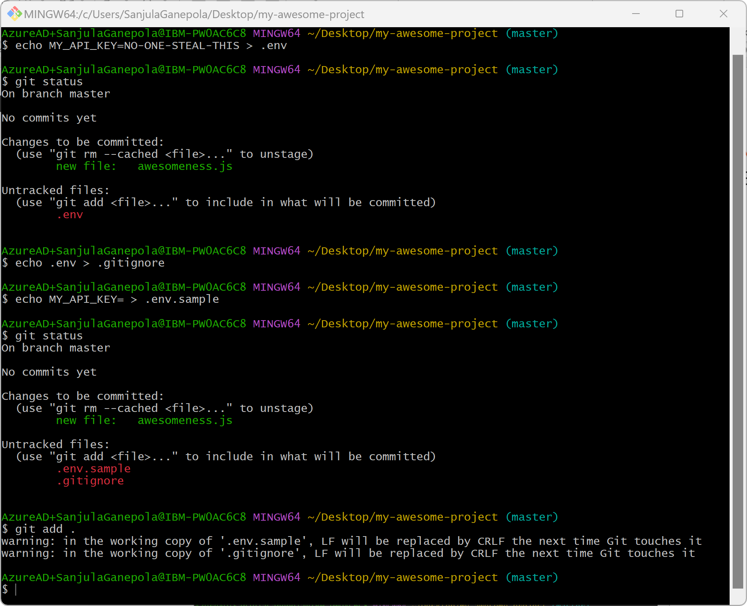
Excluding files from being tracked
WORKING DIRECTORY
STAGING AREA
LOCAL REPO
REMOTE REPO

Slide 10
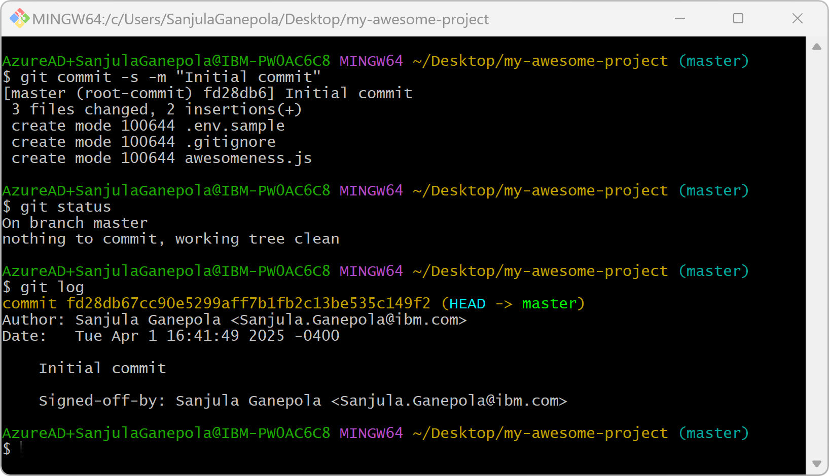
Committing files to the local repository
WORKING DIRECTORY
STAGING AREA
LOCAL REPO
REMOTE REPO

Slide 11
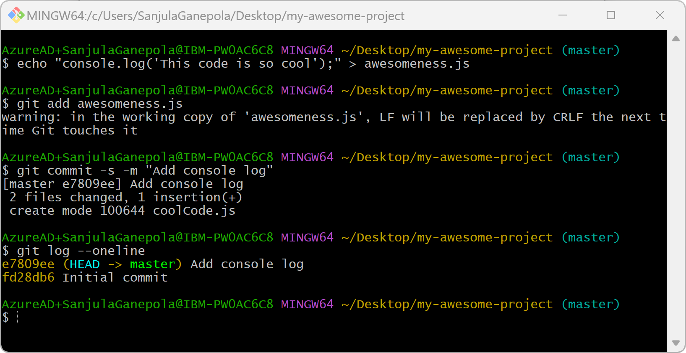
Committing more files
WORKING DIRECTORY
STAGING AREA
LOCAL REPO
REMOTE REPO

Slide 12

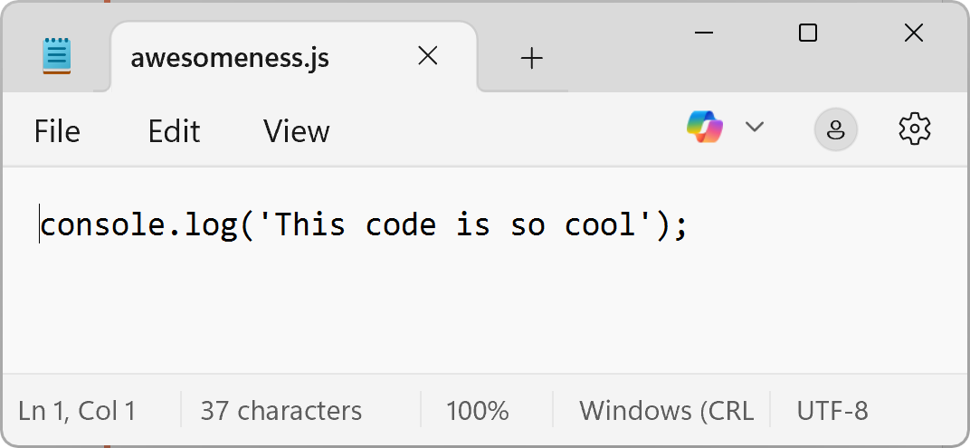
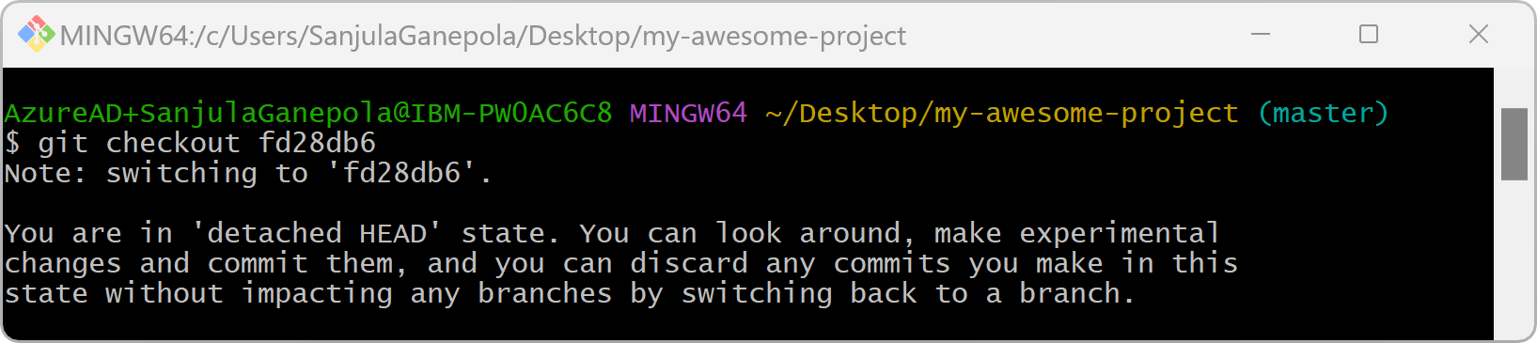
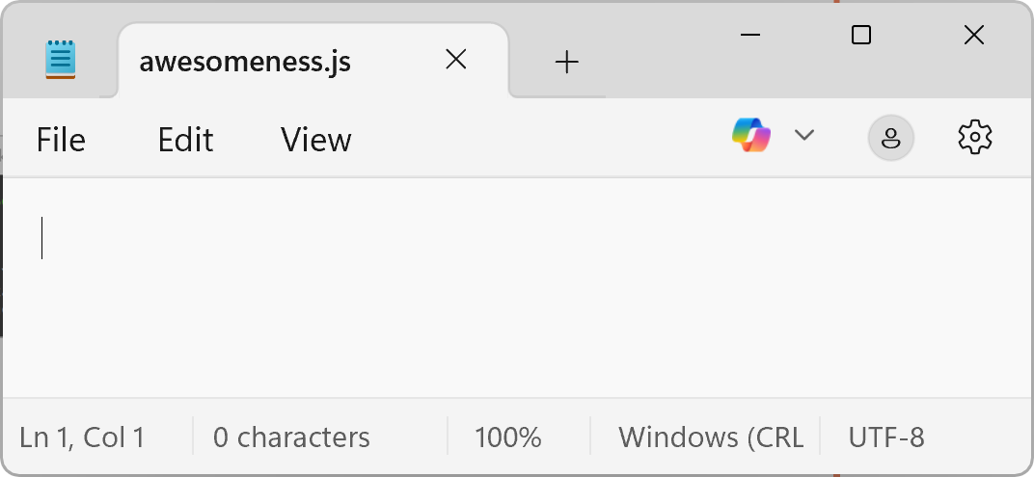
Checking out a specific commit
e7809ee Add console log
fd28db6 Initial commit

Slide 13
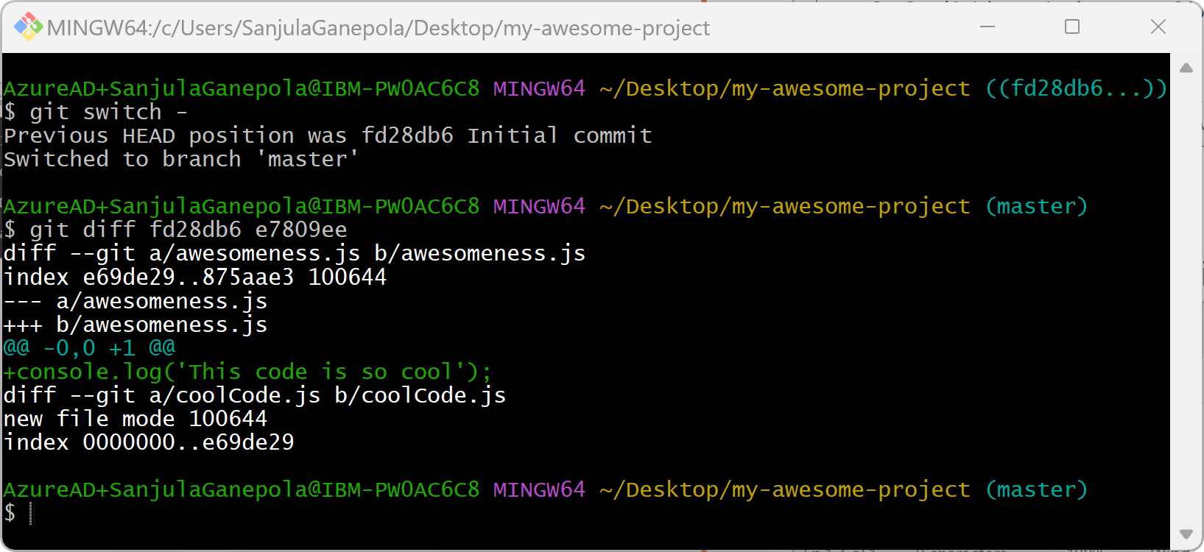
Comparing two commits

Slide 14
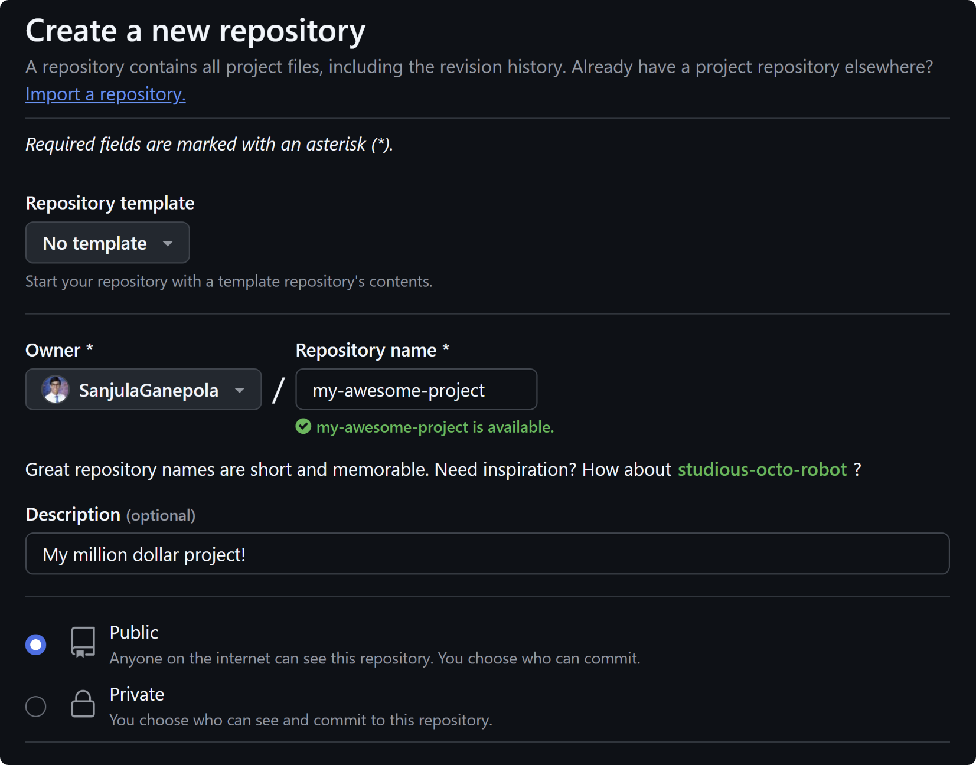

Creating a remote repository

Slide 15
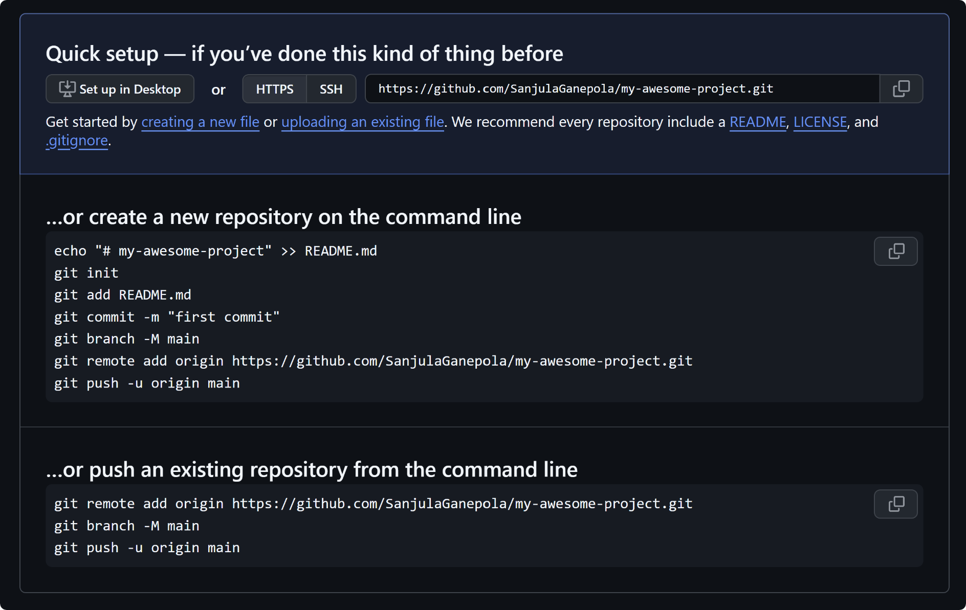
Using the quick setup instructions
https://github.com/SanjulaGanepola/my-awesome-project

Slide 16
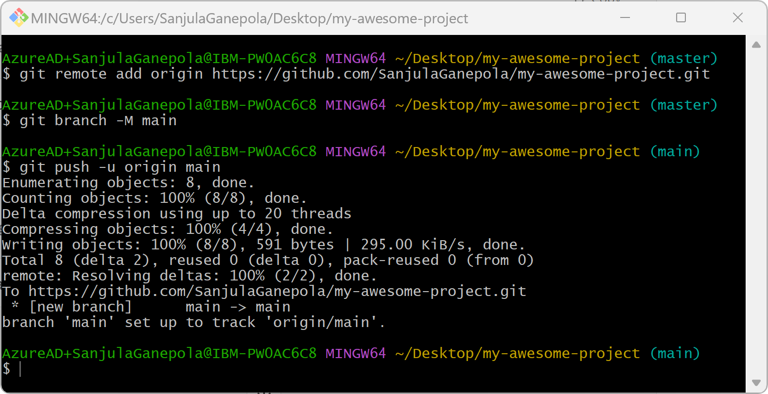
Pushing to the remote repository
WORKING DIRECTORY
STAGING AREA
LOCAL REPO
REMOTE REPO

Slide 17
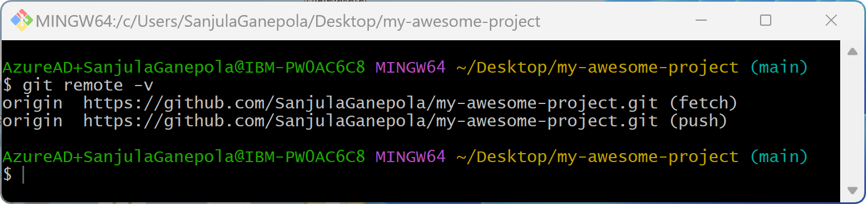
Listing the remote repositories

Slide 18
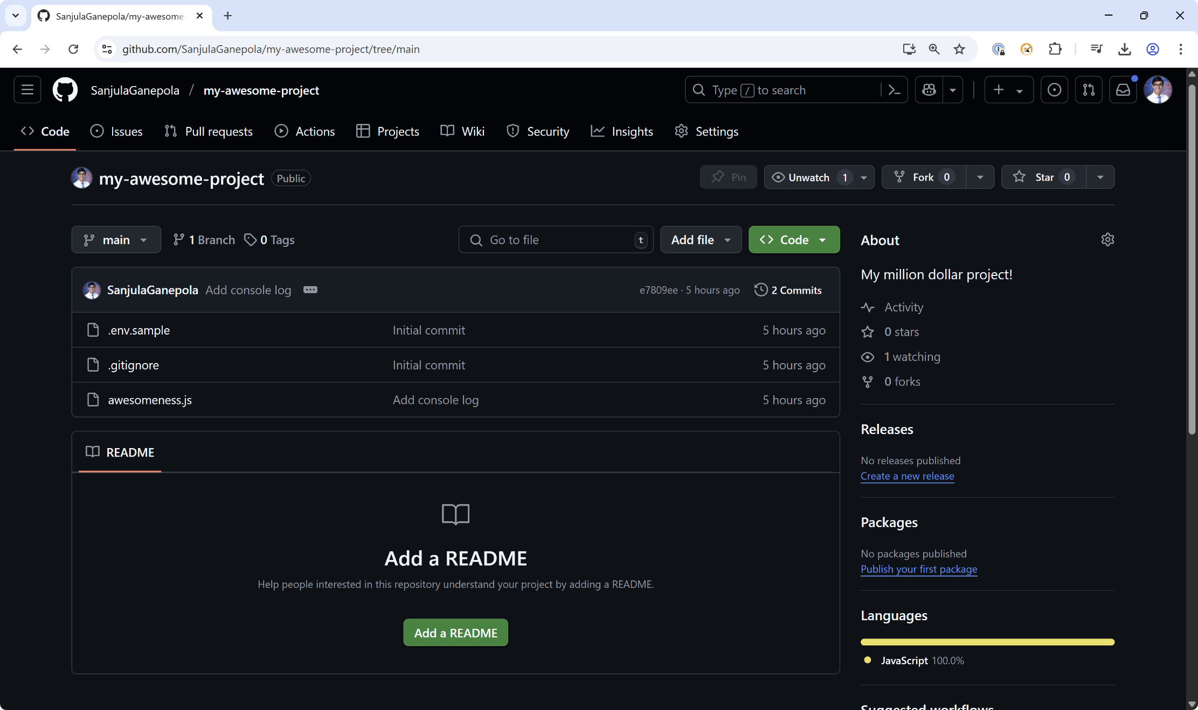
Viewing the remote repository

Slide 19
Using Git in a Team

Slide 20
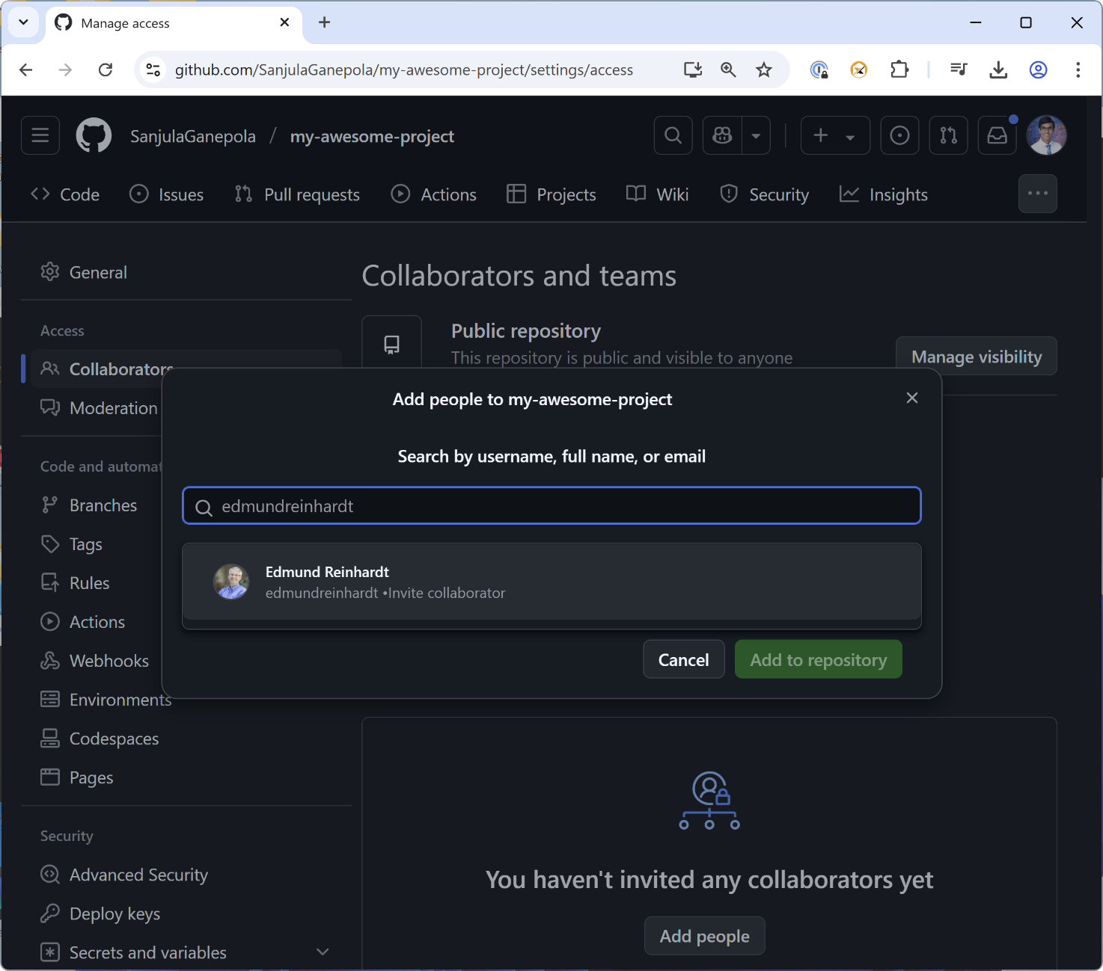
Adding collaborators

Slide 21
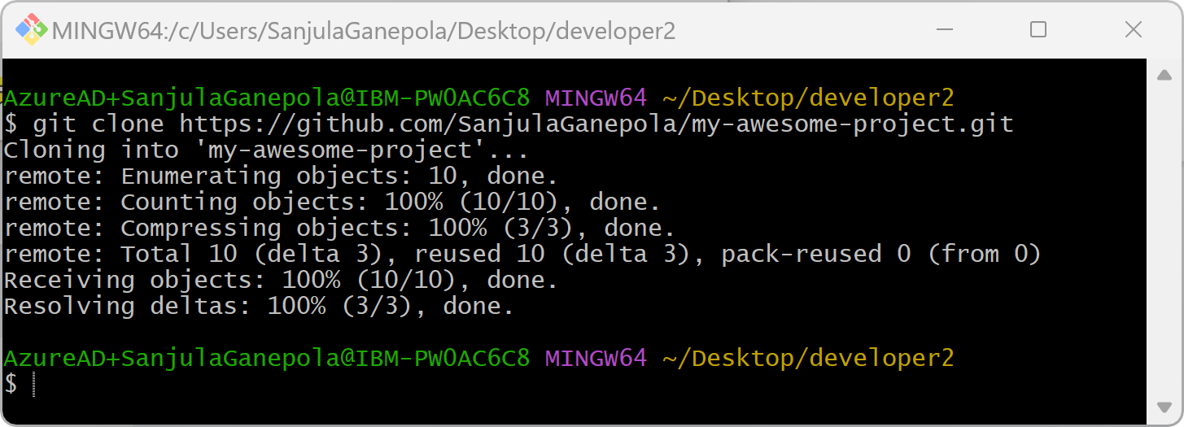
Cloning the remote repository
WORKING DIRECTORY
STAGING AREA
LOCAL REPO
REMOTE REPO
👨‍💻
Edmund (Team Member)

Slide 22
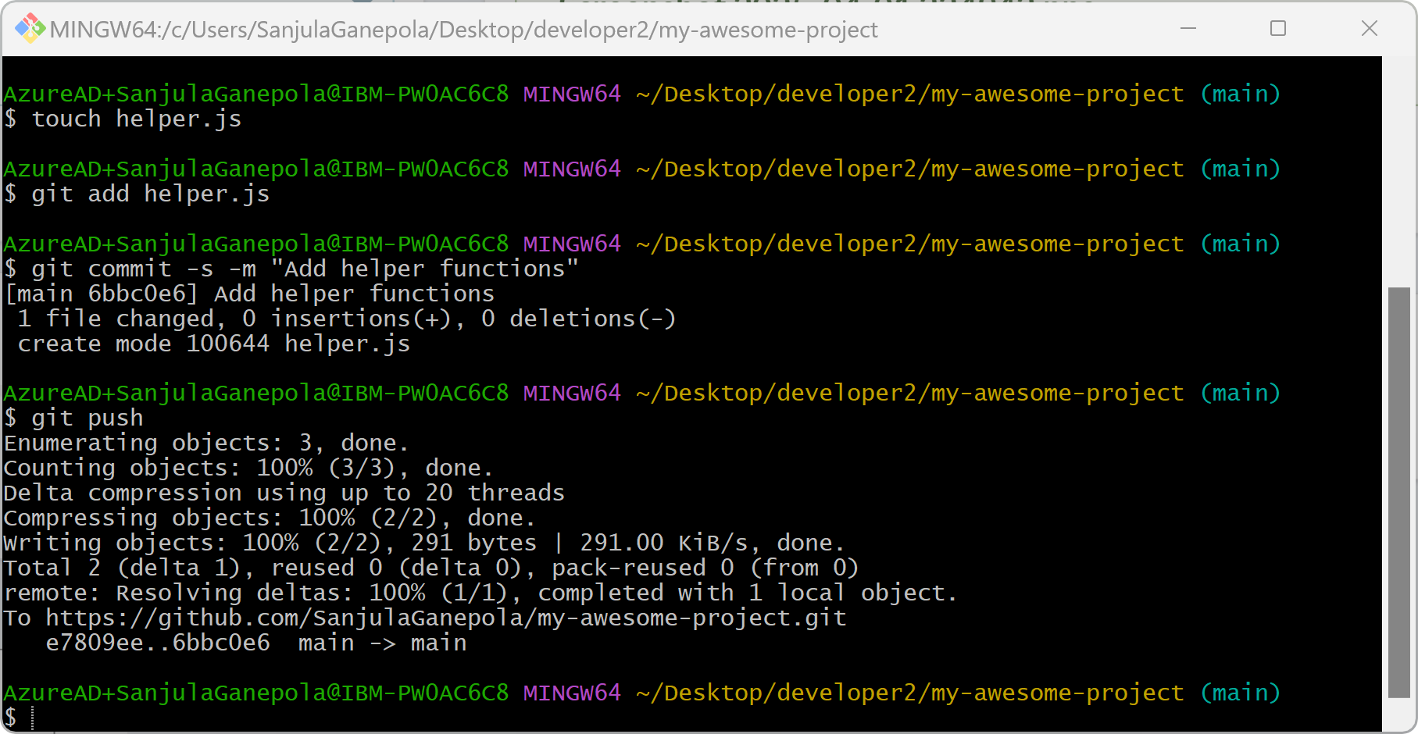
Working → Staging → Committing → Pushing
WORKING DIRECTORY
STAGING AREA
LOCAL REPO
REMOTE REPO
👨‍💻
Edmund (Team Member)

Slide 23
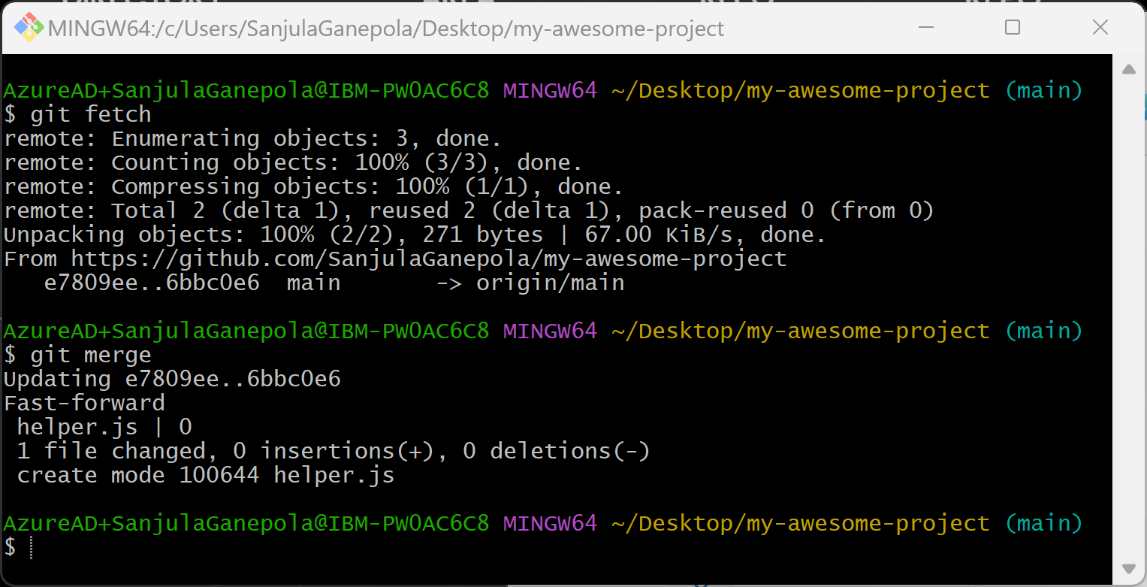
Option 1: Fetching and merging from the remote repository
WORKING DIRECTORY
STAGING AREA
LOCAL REPO
REMOTE REPO
MERGE
FETCH
👨‍💻
Sanjula (Owner)

Slide 24
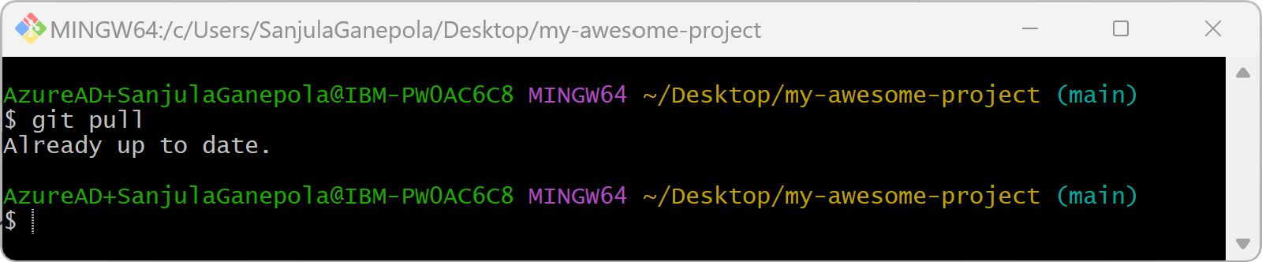
Option 2: Pulling from the remote repository
WORKING DIRECTORY
STAGING AREA
LOCAL REPO
REMOTE REPO
PULL
👨‍💻
Sanjula (Owner)

Slide 25
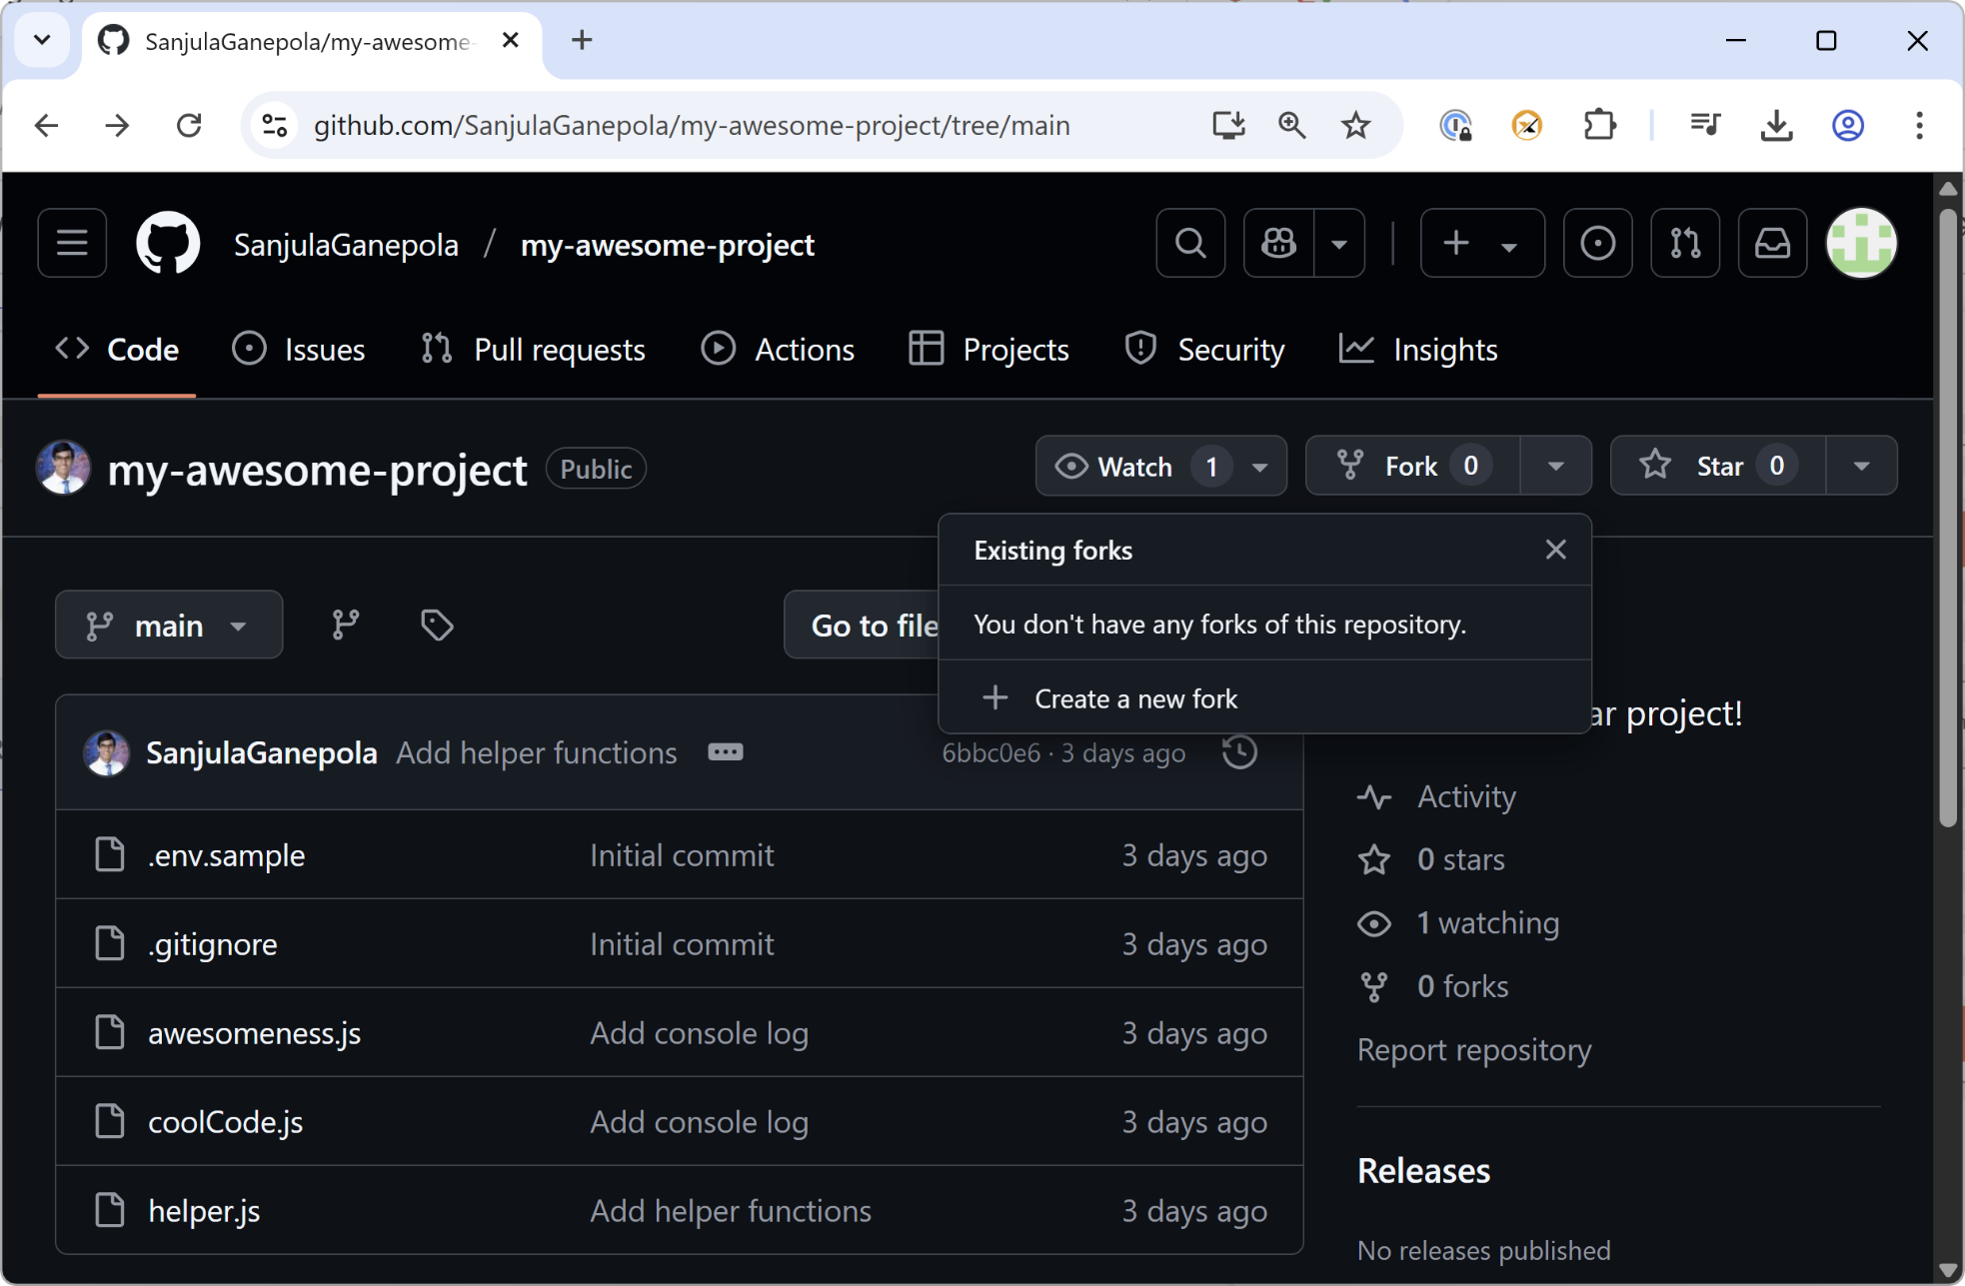
Creating a fork
👨‍💻
John (Outside Collaborator)

Slide 26
Upstream vs. Origin
Remote GitHub Repo - Original
Remote GitHub Repo - Fork
upstream
origin
Local Repo

Slide 27
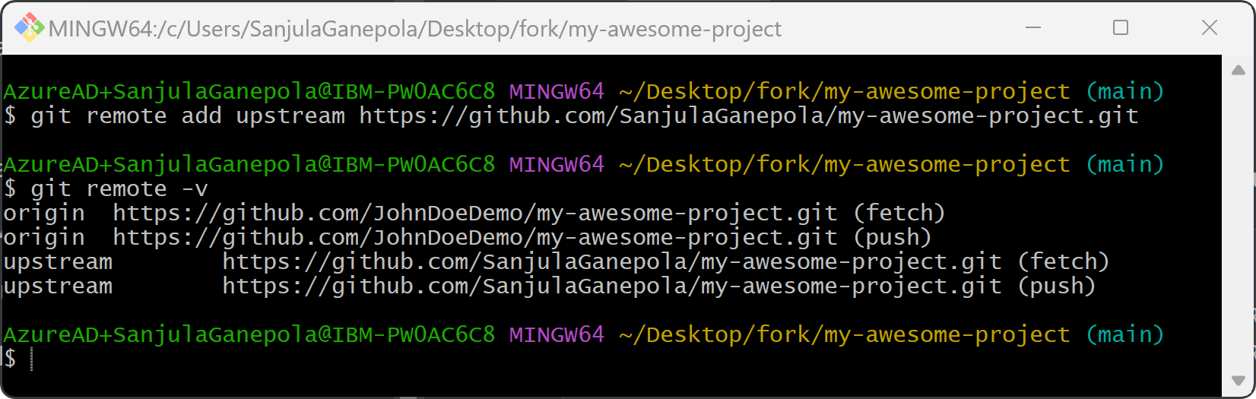
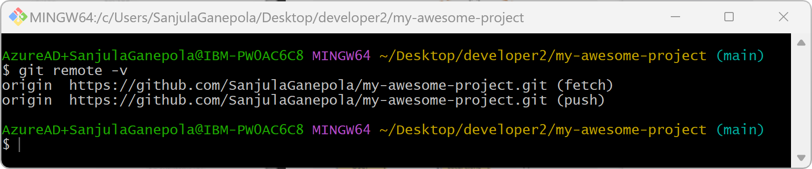
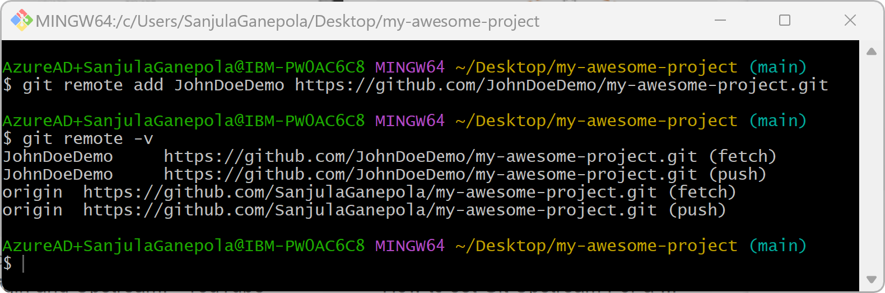
Listing Remote Repositories
👨‍💻
John (Outside Collaborator)
👨‍💻
Edmund (Team Member)
👨‍💻
Sanjula (Owner)

Slide 28
Branching and Merge Conflicts

Slide 29
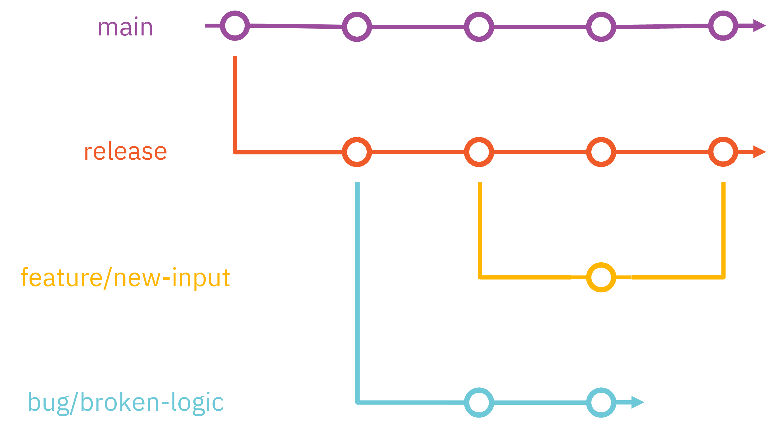
Branching in Git

Slide 30
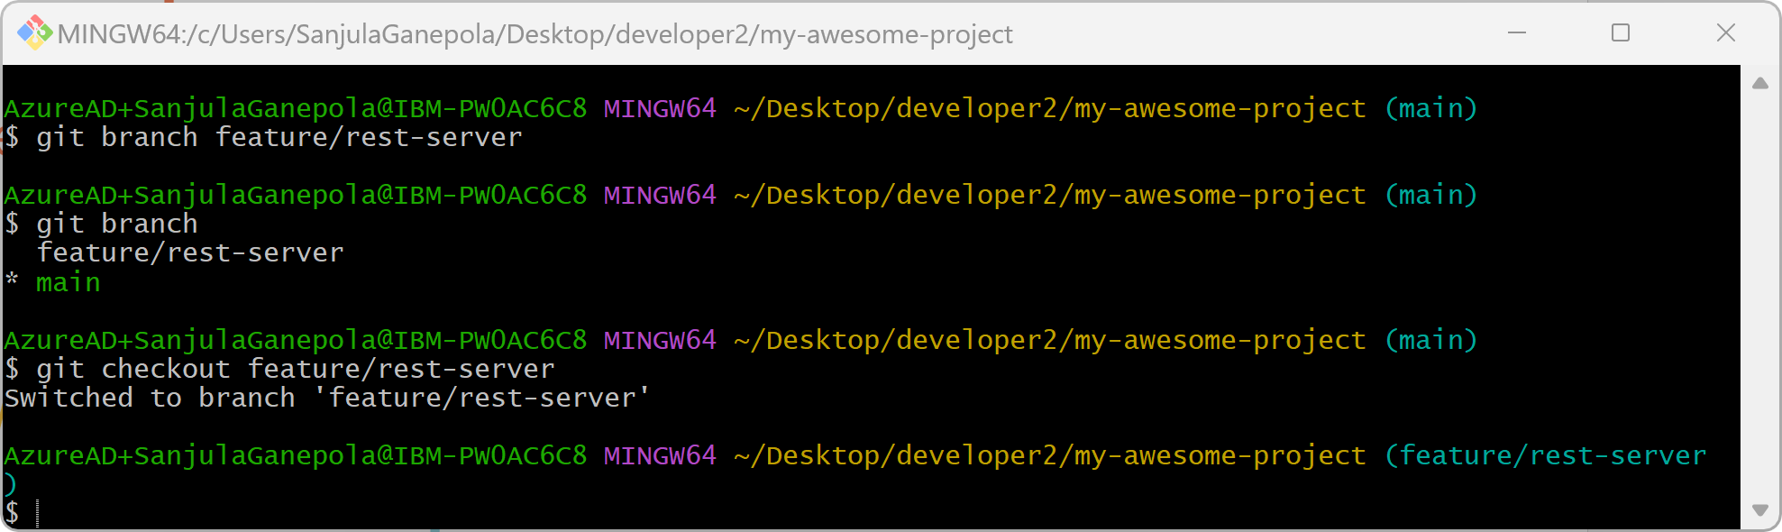
Creating and checking out a branch

Slide 31
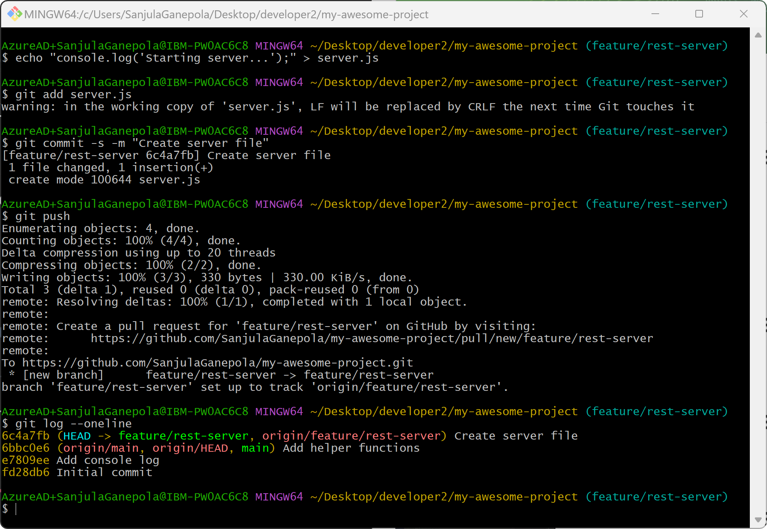
Pushing to the branch
feature/rest-server
Create server file
main
Add helper functions
Add console log
Initial commit

Slide 32
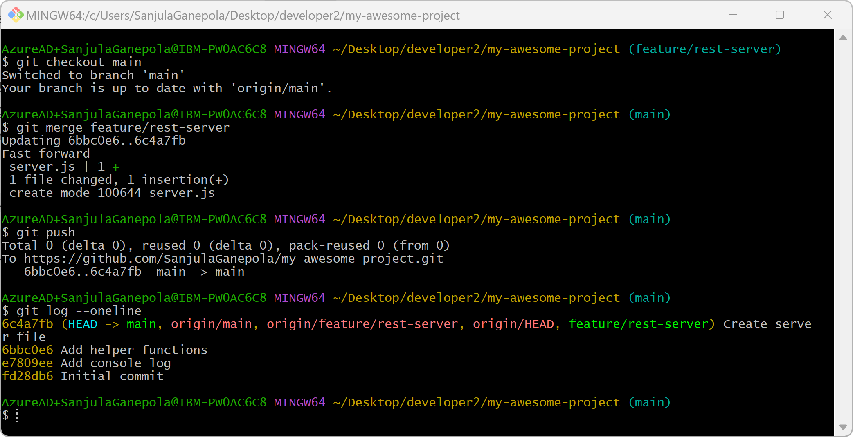
Merging branches

Slide 33
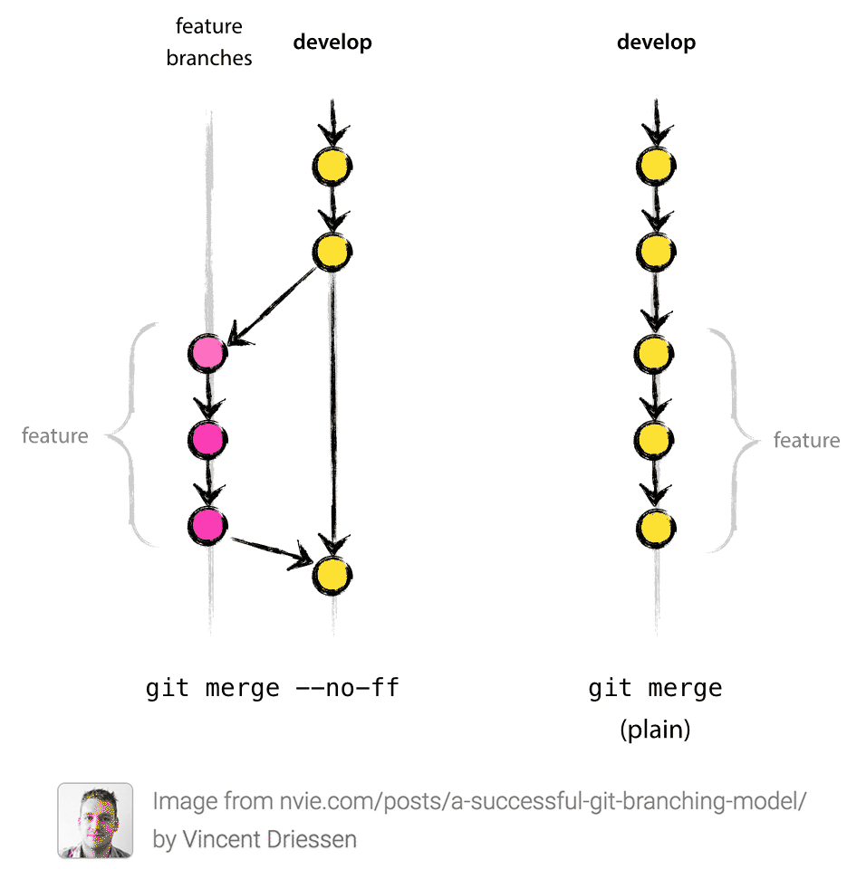
Fast forward merge vs non-fast forward merge

Slide 34
When can merge conflicts happen?
main
A
B
C
fix/bug-123
X
Y

Slide 35
3-way merge
main
A
B
C
fix/bug-123
X
Y
Current changes
C
diff
B
Δ1
Incoming changes
Y
diff
B
Δ2

Slide 36
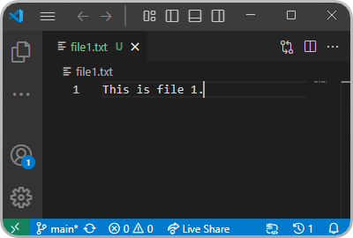

Scenario 1: No file overlap

Slide 37
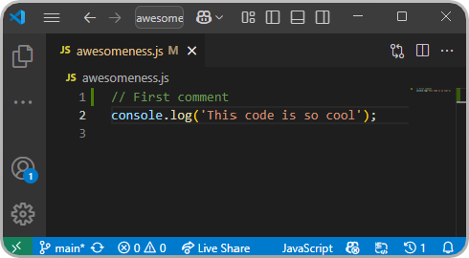
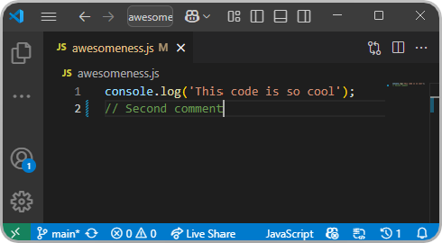
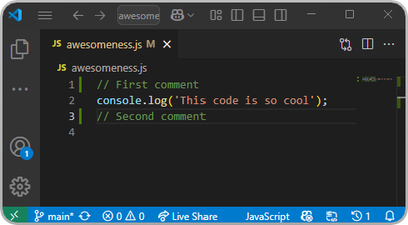
Scenario 2: No line overlap

Slide 38
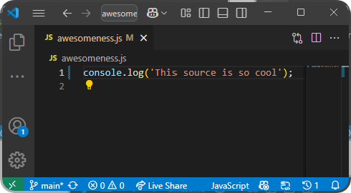
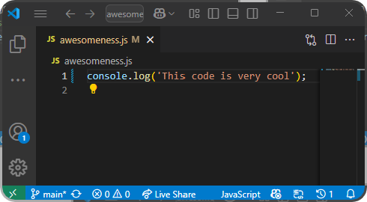
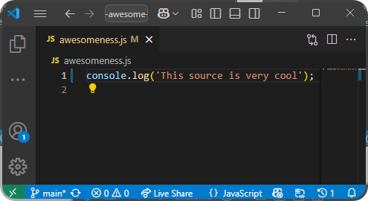
Scenario 3: Line overlap

Slide 39
Merge commit
main
A
B
C
D
fix/bug-123
X
Y
Merge fix/bug-123 onto main with a merge commit

Slide 40
Merge Commits vs. Rebase Merging vs. Squash Merging

Slide 41
Merge commits
main
A
B
C
D
fix/bug-123
X
Y
Merge fix/bug-123 onto main with a merge commit

Slide 42
Rebase merging
main
A
B
C
fix/bug-123
X
Y
Append commits in fix/bug-123 onto the front of main
main
A
B
C
X’
Y’

Slide 43
Squash merging
main
A
B
C
fix/bug-123
X
Y
Combine commits in fix/bug-123 into a single commit and append onto the front of main
main
A
B
C
D

Slide 44
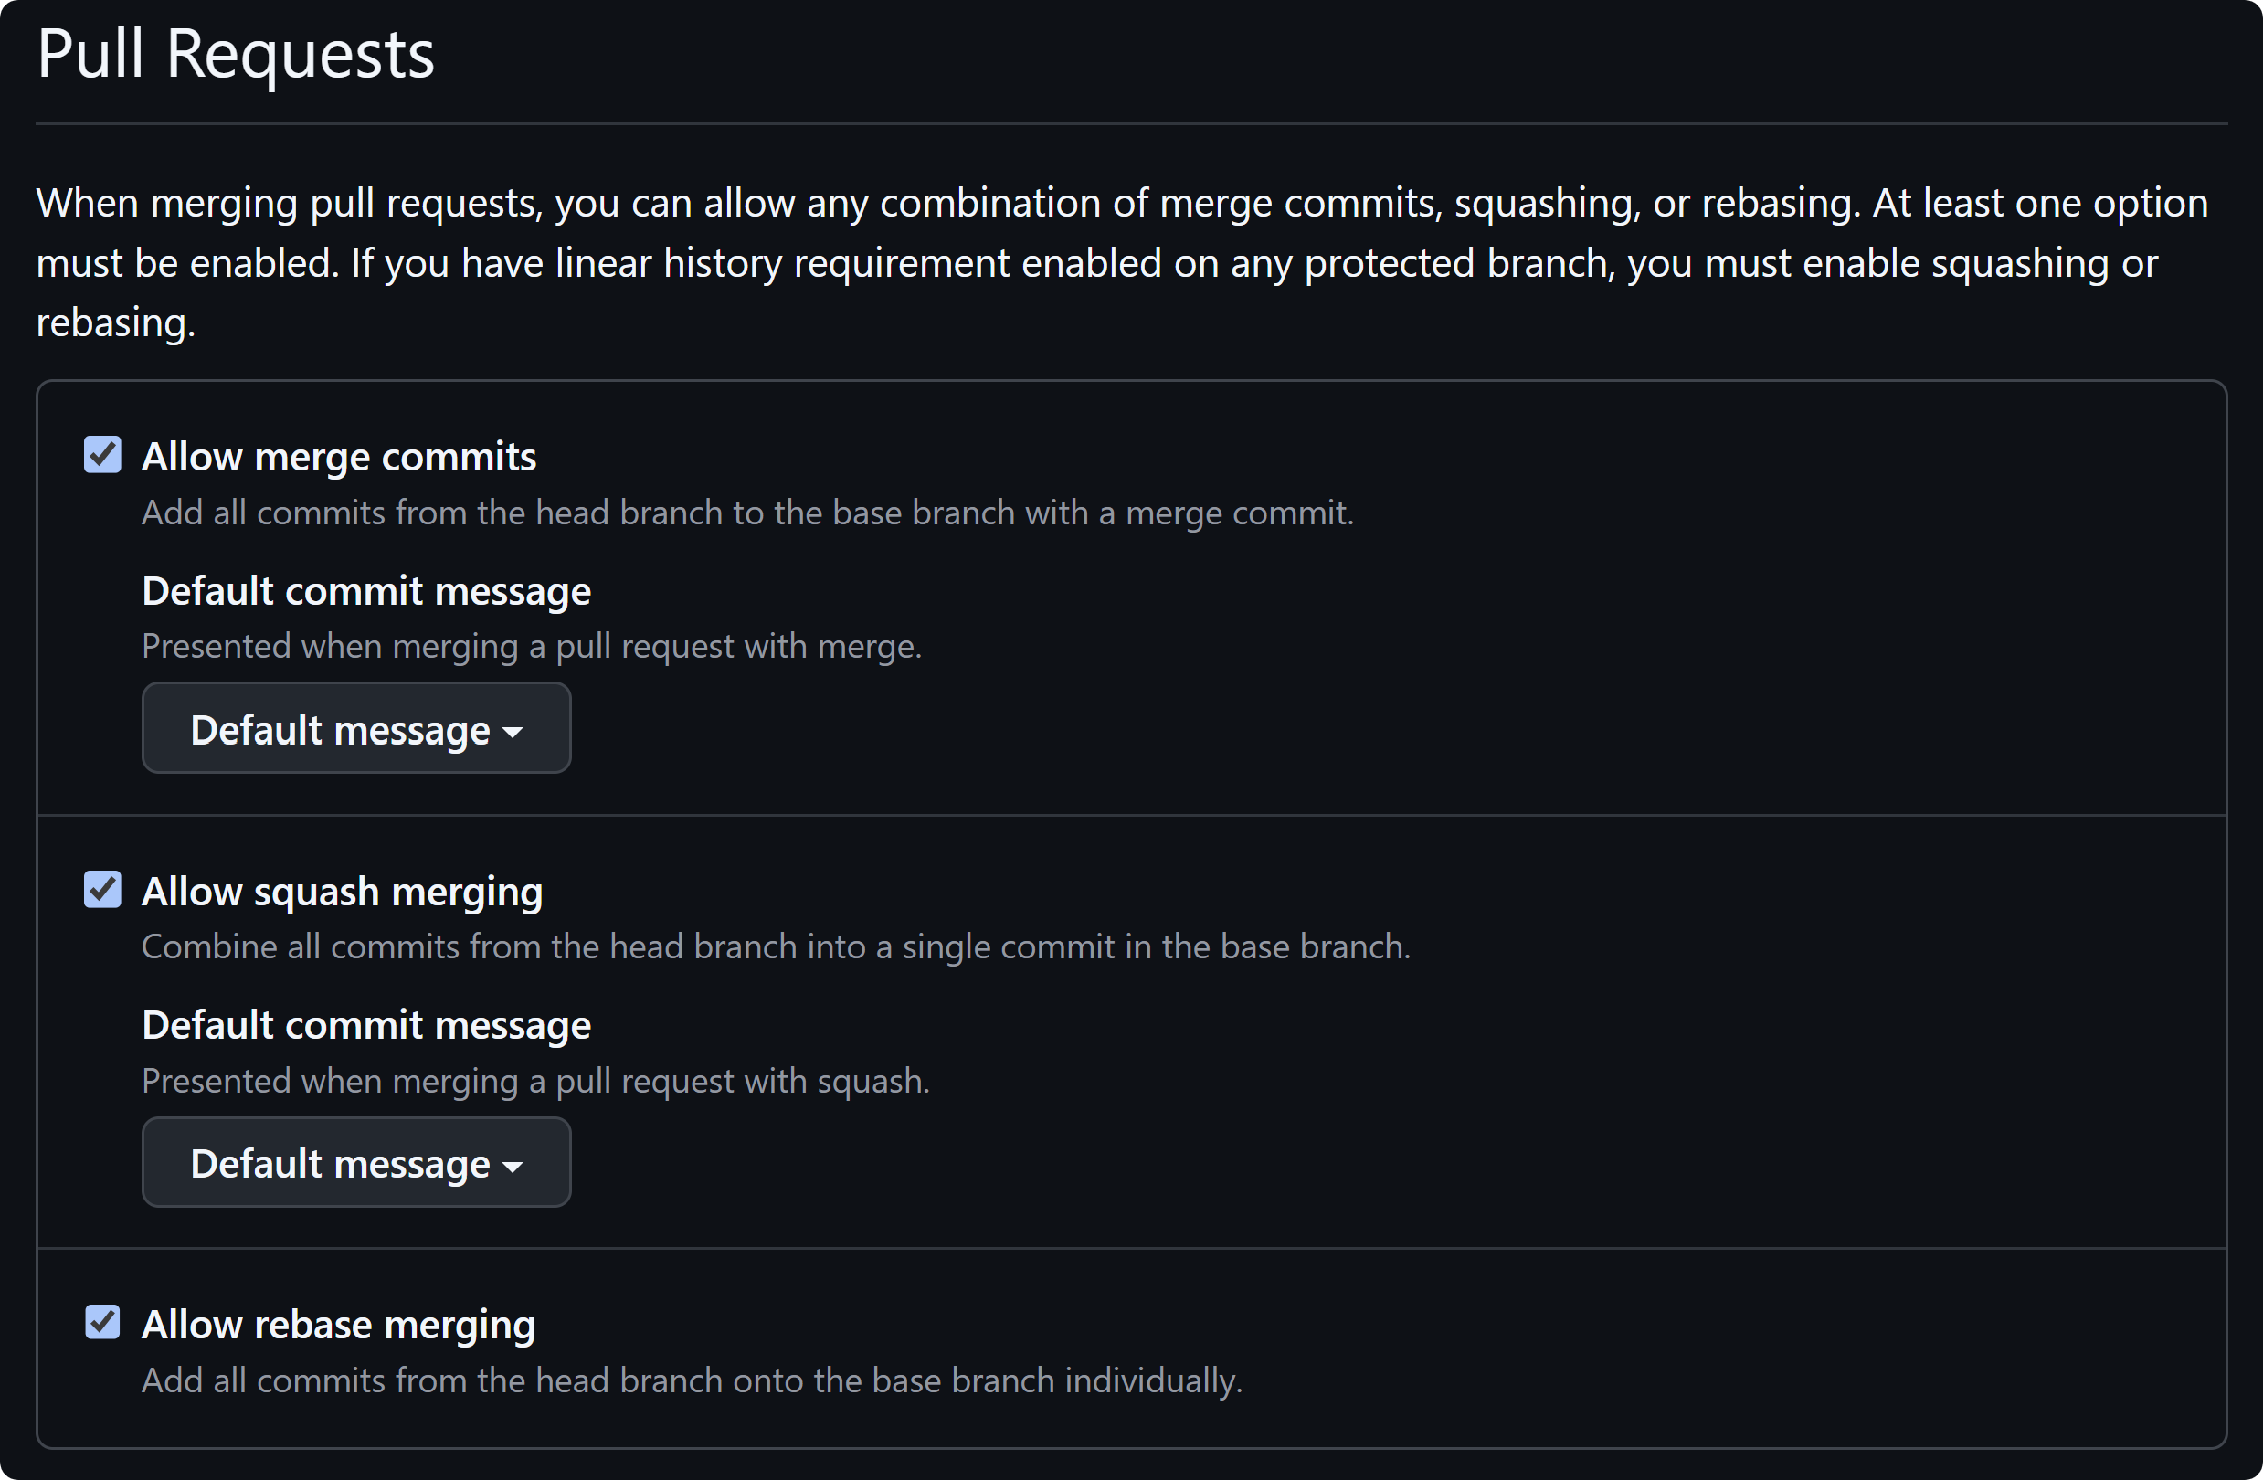
Pull request settings

Slide 45
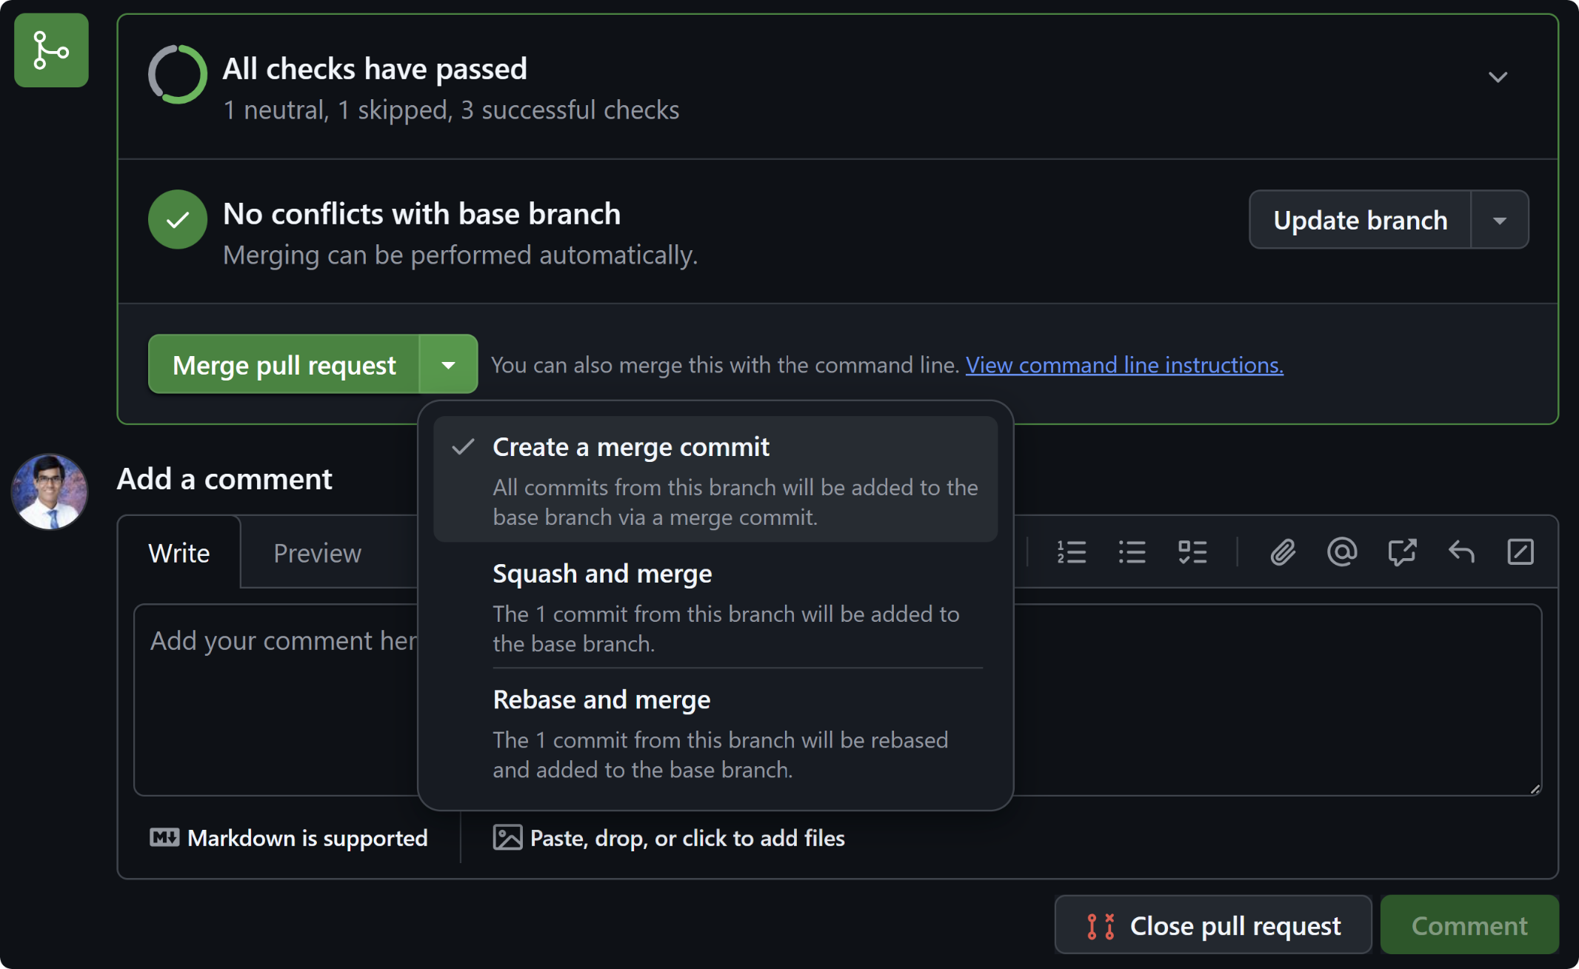
Pull request merge options

Slide 46
Using Git on IBM i

Slide 47
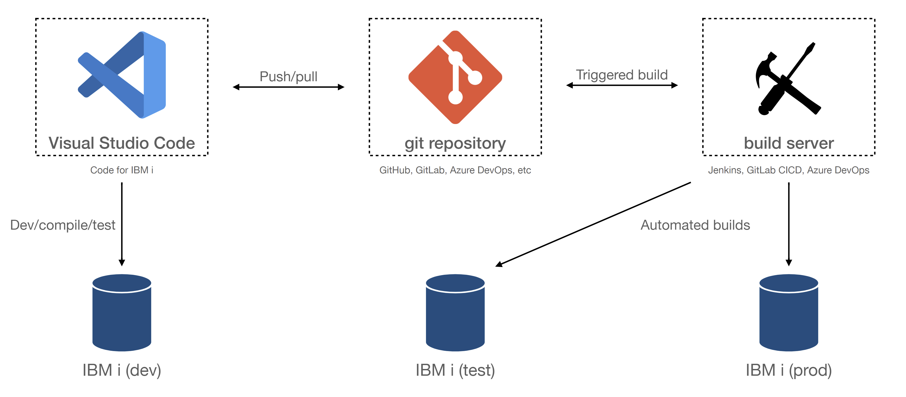
What Does Modern Development Look Like?

Slide 48
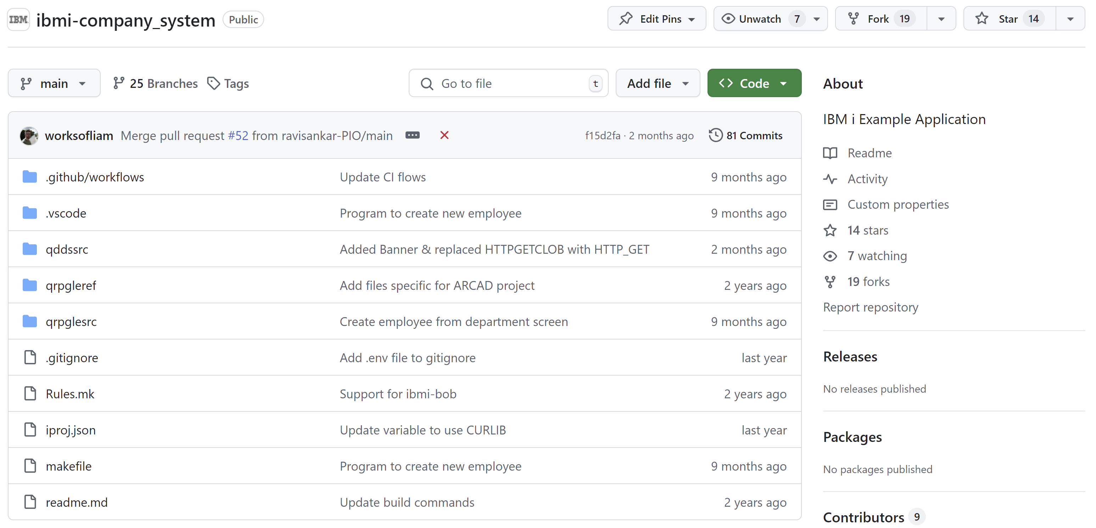
Development with Git
Source is managed by Git
Complete change history
Branching and merging capabilities
Traceability
Variety of options for Git hosting services
GitHub, GitLab, Azure DevOps, etc

Slide 49
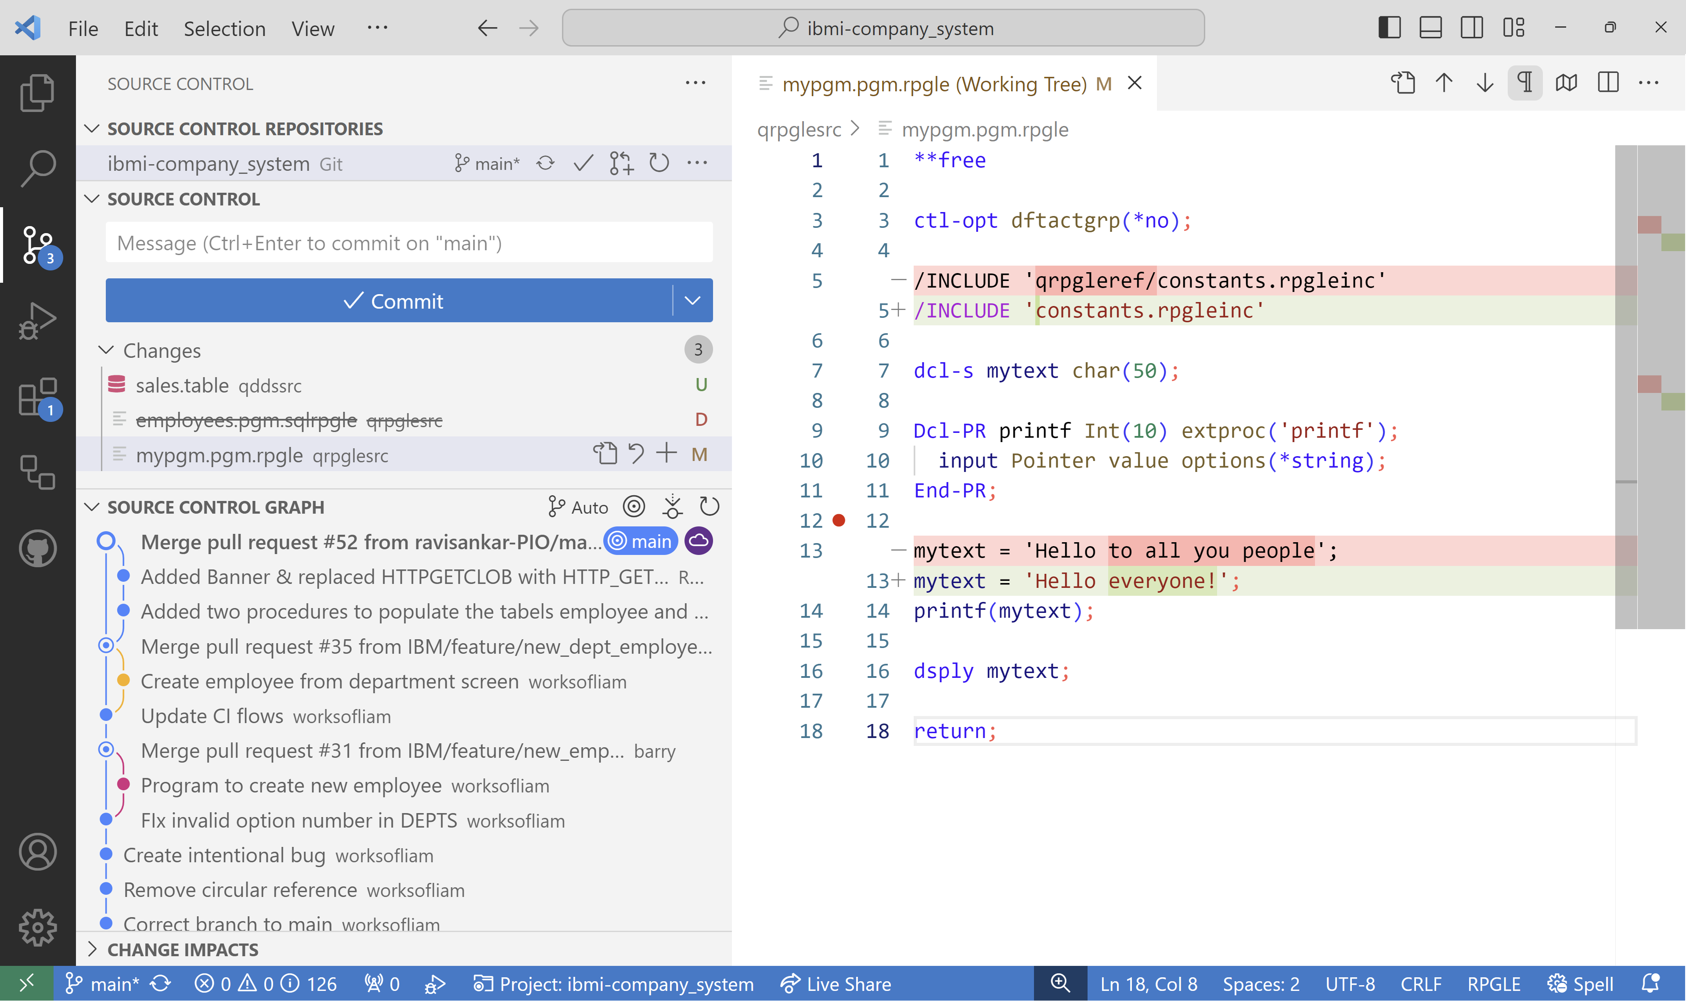
Local Development Experience
IBM i
IBM i integration via open-source extensions
Support for RPGLE, COBOL, CL, SQL, and more!
Git
First class Git support
Hundreds of Git tools
View current repository changes
View changes line by line
View a graphical representation of incoming and outgoing commits

Slide 50
Let's use a different (but similar) file system
MYPROJECT
QRPGLESRC
CUSTOMER.RPGLE
INVENTORY.RPGLE
STARTJOB.RPGLE
QSQLSRC
CUSTOMERS.SQL
INVENTORY.SQL
QCLLESRC
START.CLLE
QCMDSRC
STARTJOB.CMD
/my-project
/.git
qrpglesrc
customer.rpgle
inventory.rpgle
startjob.rpgle
qsqlsrc
customer.table
inventory.table
qcllesrc
start.clle
qcmdsrc
startjob.cmd
No more character name restrictions
Now usable with Git and Make
QSYS.LIB Library
IFS/Local File System

Slide 51
Let’s go one step further!
/my-project
/.git
qrpglesrc
customer.rpgle
inventory.rpgle
startjob.rpgle
qsqlsrc
customer.table
inventory.table
qcllesrc
start.clle
qcmdsrc
startjob.cmd
/my-project
/.git
customer-management
customer.rpgle
customer.table
inventory-service
inventory.rpgle
inventory.table
start-command
startjob.pgm.rpgle
start.clle
startjob.cmd
Flexible directory structure
IFS/Local File System
Logical Organization

Slide 52
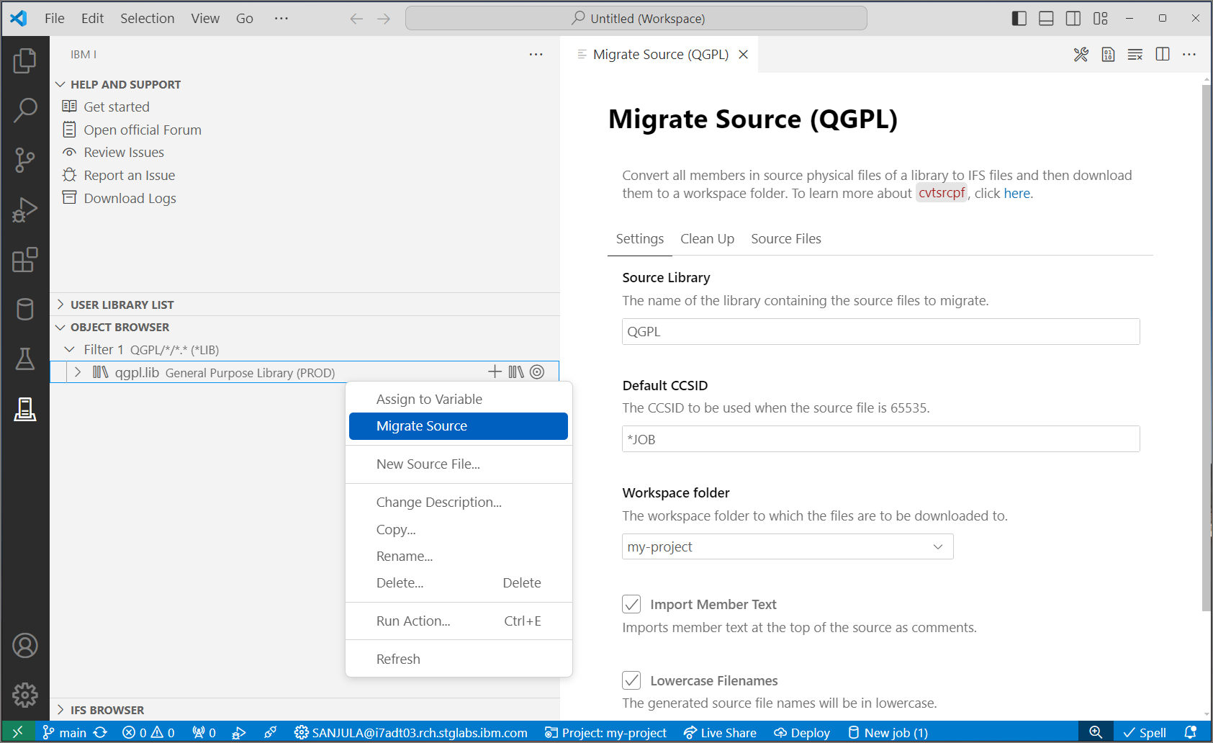


How to migrate source from QSYS?
QSYS members in source physical files
↓
Properly encoded, terminated, and named source files in an IFS directory
↓
Download to local project
↓
Rename extensions
↓
Convert includes/copy directives to Unix style paths
CVTSRCPF from BOB
Source Orbit

Slide 53

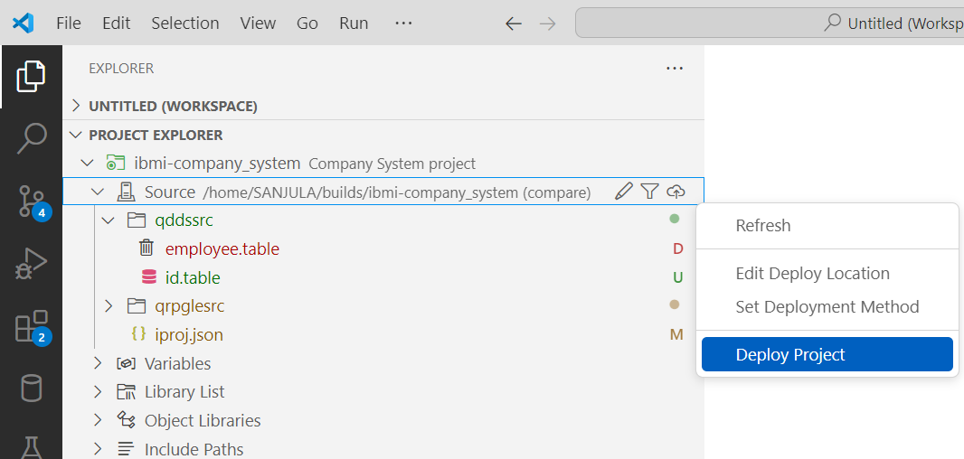
How does source get built from local files?
Set deploy location
Where source gets uploaded to
Typically set one
Each developer gets a unique location
Each repository gets a unique location
Set deployment method
Compare (typically the safest)
Changes (typically the fastest)
Working Changes
Staged Changes
All
Deploy project
Moves files to deploy location based on deployment method
Deploy
Build
Local Project
IFS Directory
Target Library

Slide 54
How to work efficiently with these 3 components?

Slide 55
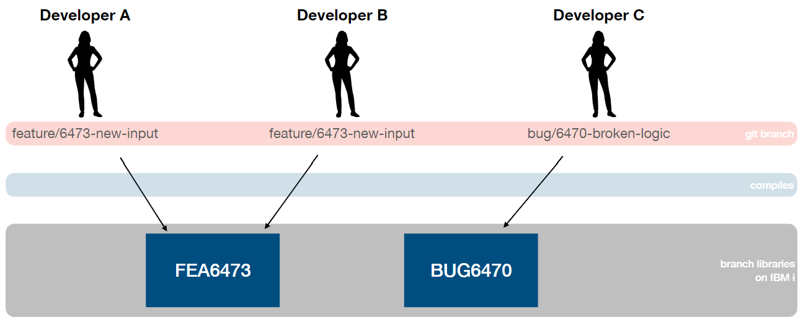
Map Git branches to libraries on IBM i

Slide 56
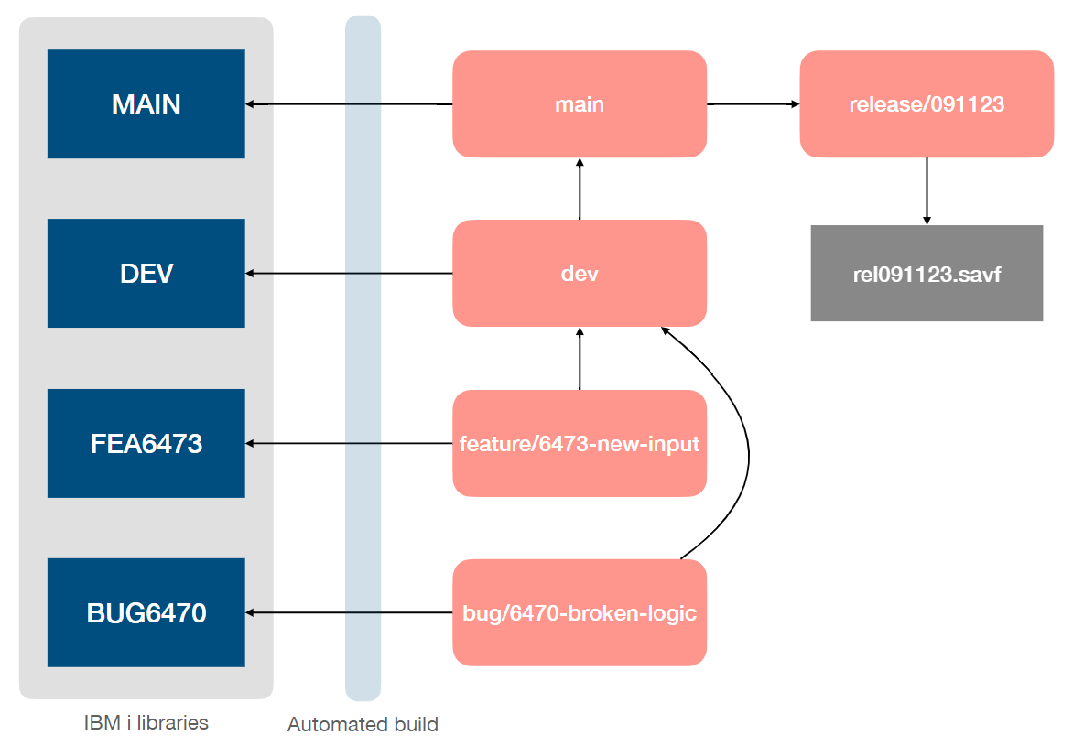
Build Server
Let’s go one step further and automate this process
Generate save files when releases are created
Automate build into branch library when Git branch is updated

Slide 57
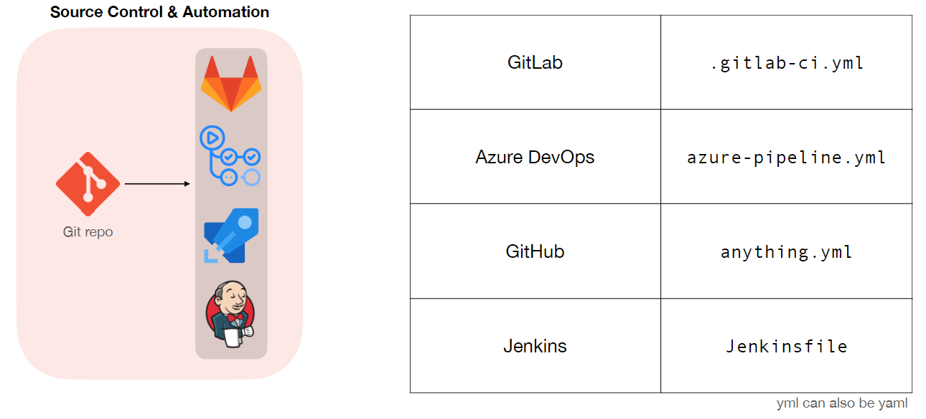
How to create workflows?

Slide 58
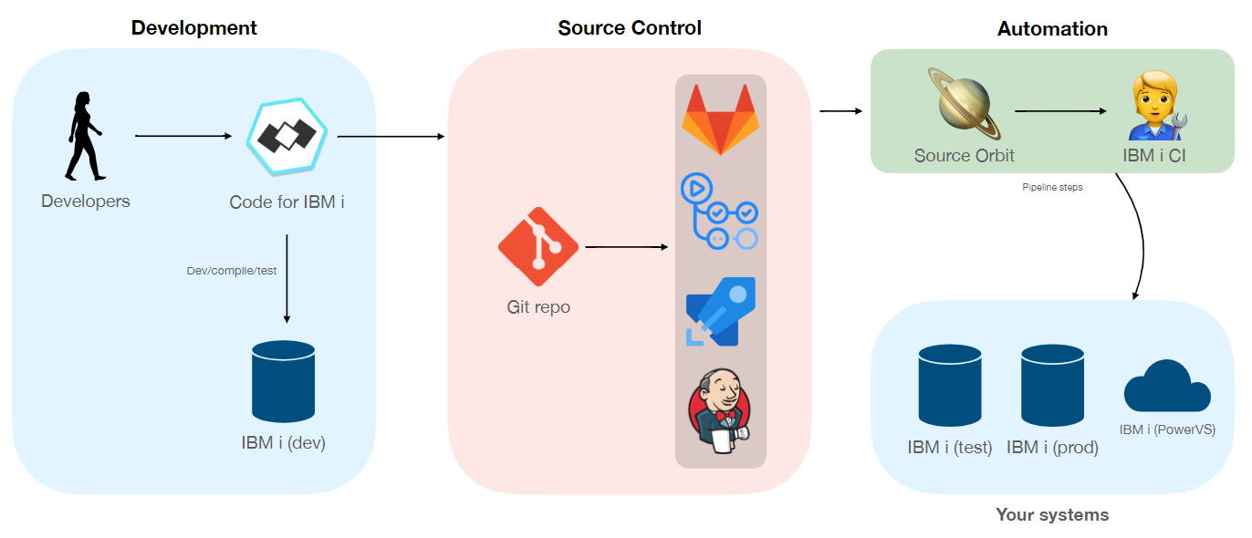
How to achieve automation with IBM i?

Slide 59
Tips and Tricks

Slide 60
Git hooks
https://git-scm.com/book/en/v2/Customizing-Git-Git-Hooks
WORKING DIRECTORY
STAGING AREA
LOCAL REPO
REMOTE REPO
pre-commit
pre-push

Slide 61
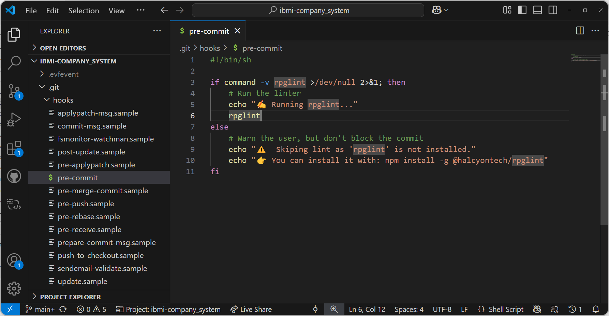
Pre-commit to run RPG linter

Slide 62
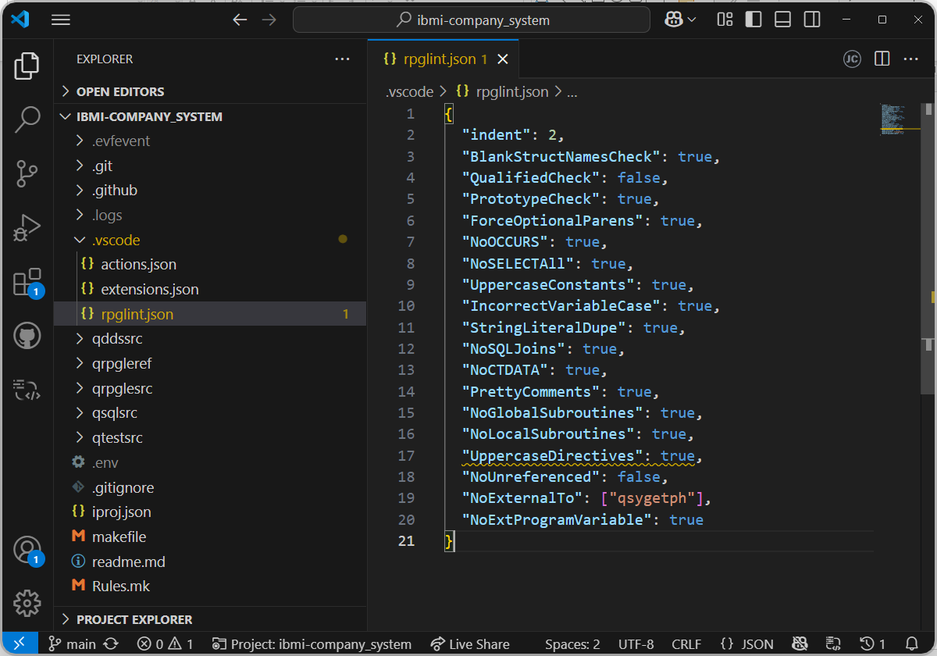
Setup lint config

Slide 63
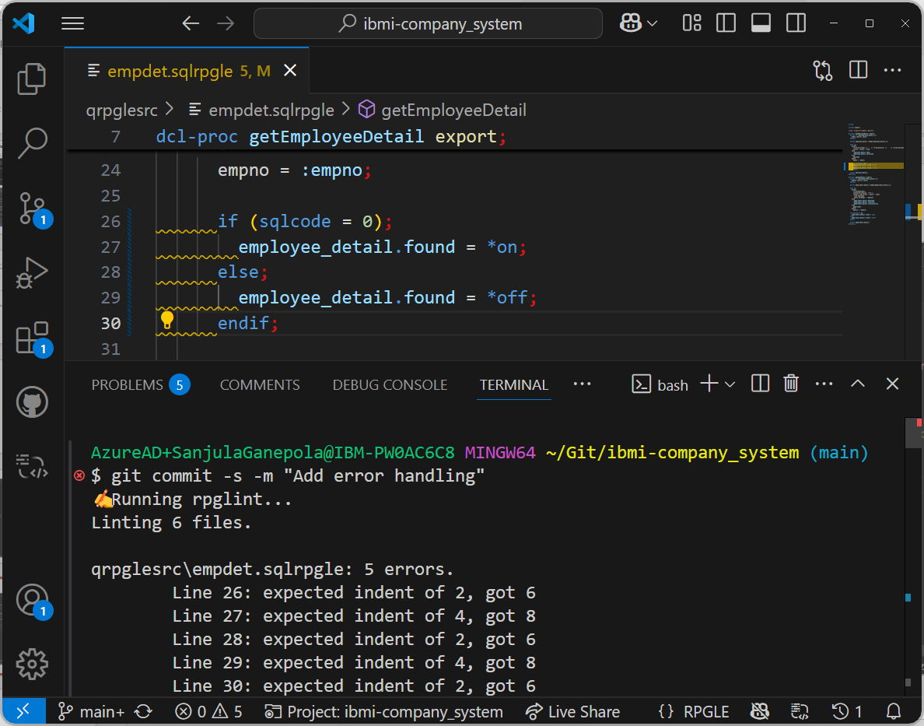
Git hooks

Slide 64

Git blame

Slide 65

Stashing changes temporarily

Slide 66

Git Configs
Scopes of configuration
System: System-wide configuration
C:\Program Files\Git\etc\gitconfig
/etc/gitconfig
Global: User specific configuration
C:\Users\<user>\.gitconfig
/home/<user>/.gitconfig
Local: Repository specific configuration
<git_repo>/.git/config
Git Config Docs: https://git-scm.com/docs/git-config

Slide 67

Without auto setup remote branch config

Slide 68


With auto setup remote branch config

Slide 69


Alias to undo commits

Slide 70


Alias to search all commits for a message

Slide 71

Git Large File Storage (LFS)
Open-source Git extension for versioning large files!
↪ Git LFS handles large files by storing references to the file in the repository, but not the actual file itself.
Install: Run git lfs install on your PC.
Track File Types: Run git lfs track "*.psd"
Track .gitattributes: git add .gitattributes
Use Git as normal!
Git LFS Docs: https://git-lfs.com/

Slide 72

Git bisect
🚨

Slide 73

Git bisect

Slide 74

Git bisect

Slide 75

Git bisect

Slide 76

Git bisect

Slide 77

Git bisect
🚨

Slide 78

Git bisect
🚨

Slide 79
Git in VS Code

Slide 80

Viewing changes and in-editor diff

Slide 81

Viewing Git history as a graph

Slide 82

Viewing pull requests
https://marketplace.visualstudio.com/items?itemName=GitHub.vscode-pull-request-github

Slide 83

Viewing changes in pull requests
https://marketplace.visualstudio.com/items?itemName=GitHub.vscode-pull-request-github

Slide 84
Any Questions?

Slide 85
Important Links
Installation
https://git-scm.com/downloads
https://git-lfs.com/
https://marketplace.visualstudio.com/items?itemName=GitHub.vscode-pull-request-github
Documentation
https://git-scm.com/docs
Recommended Git Tutorials
https://www.youtube.com/watch?v=-iWaarLI7zI
https://www.youtube.com/watch?v=e9lnsKot_SQ
https://www.youtube.com/watch?v=0chZFIZLR_0&t=66s

Slide 86

Sanjula Ganepola - Git Concepts I Wish I Knew Years Ago
Please take the last minute of this session to complete the evaluation. A direct link to the evaluation can be found using the QR code to the right.

